Slide 1

MedTech Performance
Week 0 Career Challenge: Strategic Time Management & Priority Alignment

Slide 2

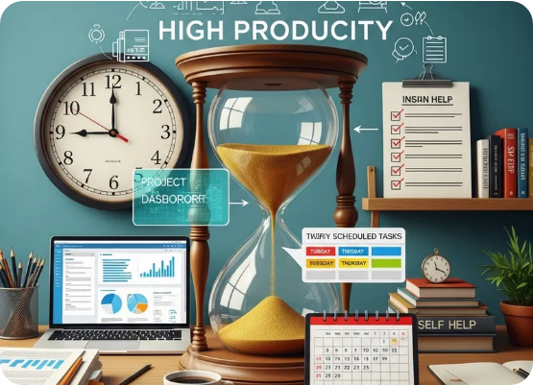
Auditing the Last 7 Days
Identifying the "Time Leaks"
Tracking 168 total hours revealed that passive activities were consuming high-energy windows. While academic commitments remained steady, "Shadow Work" and digital distractions significantly diluted the quality of deep work sessions.
Primary Insight: We don't lack time; we lack intentionality.

Slide 3
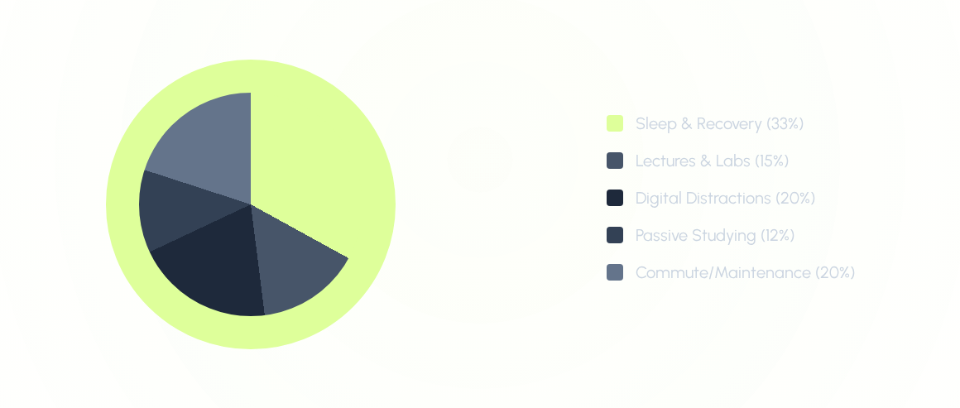
Where the Time Actually Went

Slide 4
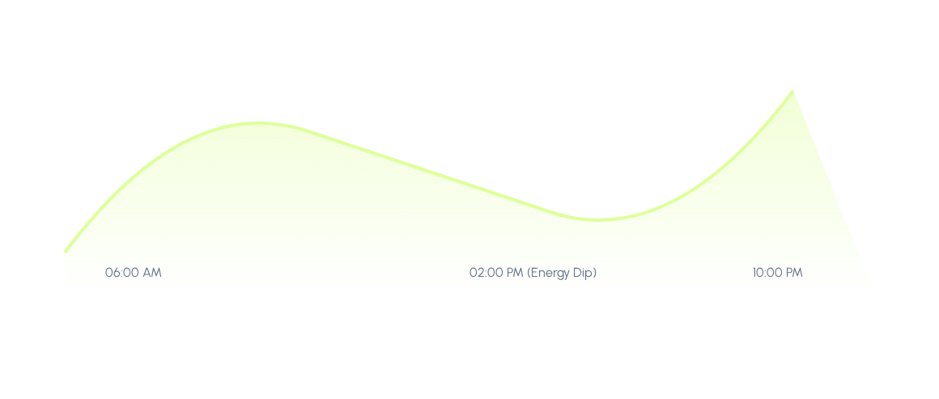
Biometric Focus Trends
Leveraging morning peaks for Deep Work blocks.

Slide 5
The 20-Hour Window
A Realistic Weekly Strategy

Slide 6
Protected MedTech Blocks
Block Type | Monday - Friday | Saturday | Sunday
Deep Focus | 07:00 - 10:00 (MedTech/Lectures) | 09:00 - 12:00 (MedTech) | Rest / Planning
Reactive | 10:00 - 12:00 (Lectures/Meetings) | Errands | Family/Social
Evening Sprint | 20:00 - 21:00 (Review) | Reflection | Prep for Week 1

Slide 7





Framework: Eisenhower Matrix
Q1: DO
Q2: SCHEDULE
Q4: DELETE
Urgent exams, immediate lab submissions.
The 20-Hour MedTech Challenge. Strategic growth and network building.
Unstructured doom scrolling, low-value digital content.

Slide 8
Quantifiable Targets
20h
15%
Protected Per Week
Screen Time Reduction

Slide 9
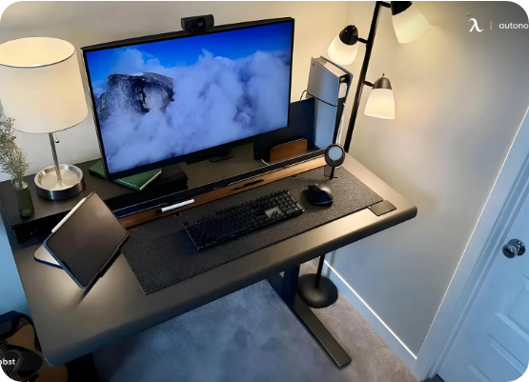
Why This Schedule Works
→
Circadian Alignment: Scheduling 20 hours of MedTech work during peak energy windows (07:00-10:00) ensures maximum cognitive throughput.
→
Protected Windows: By "blocking" time, these hours become non-negotiable appointments with career growth.
→
Recovery Buffers: Sunday is intentionally left for active recovery to prevent burnout in a high-pressure MedTech environment.

Slide 10
"Time is what we want most, but what we use worst."
— William Penn

Slide 11


Vision for Excellence
Consistent, disciplined scheduling is the foundation of MedTech innovation. By protecting 20 hours, we aren't just managing time, we are engineering success.

Slide 12
Next Steps?
Implementation starts tomorrow. Ready for Week 1.

